Slide 1
Angular NgRx
First Look at NgRx
Lecture 3
By James(Jin) Wang
10/08/2022

Slide 2
Outline
Set up the sample application
Install @ngrx/store
Initialize the Store
Define the State and Actions
Build a Reducer to process Actions
Dispatch an Action to change State
Subscribe to the Store to get State changes

Slide 3
Install Store
  Install @ngrx/store
  ng add @ngrx/store
  Demo: install Store

Slide 4
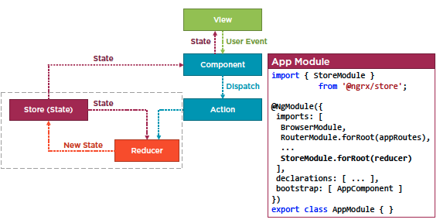
Initialize Store
  Initialize store

Slide 5
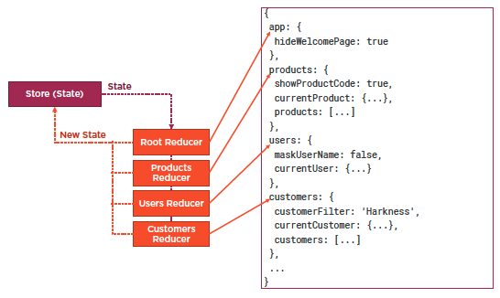
Initialize Store
  Initialize store

Slide 6
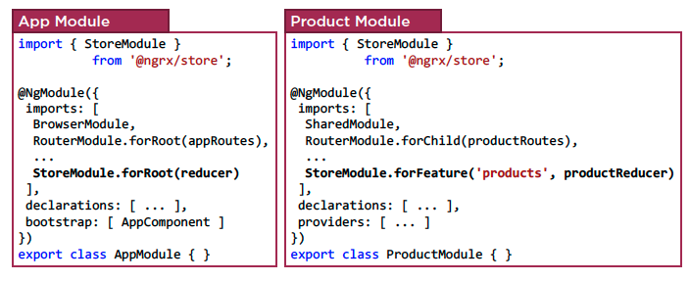
Initialize Store
  Feature Module State Composition

Slide 7
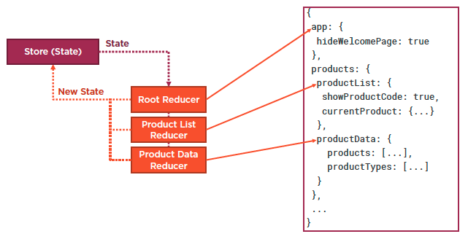
Initialize Store
  Sub-slice of State

Slide 8
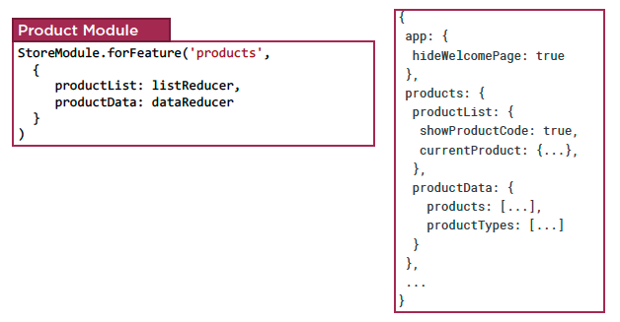
Initialize Store
  Sub-slice of State

Slide 9
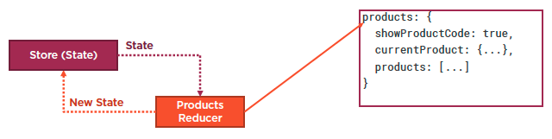
Initialize Store
  Sub-slice of State
  Demo: initialize the Store

Slide 10
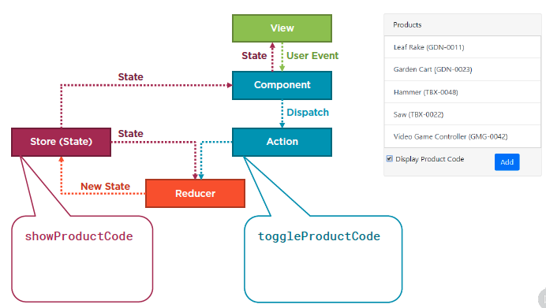
Building a Reducer
  Define the state and actions

Slide 11
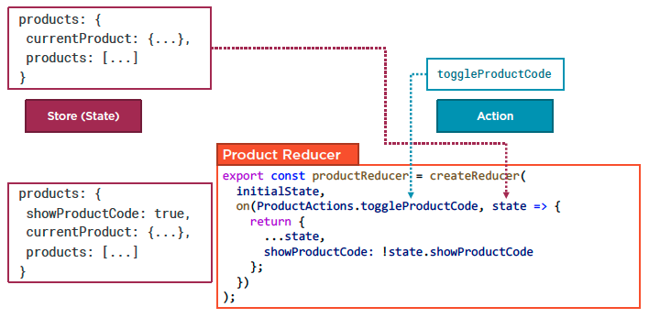
Building a Reducer
  Build reducer

Slide 12
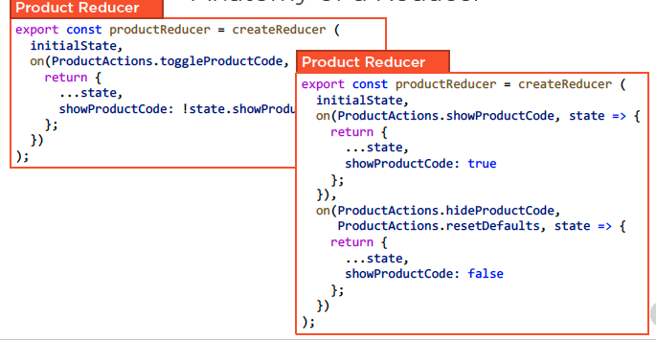
Building a Reducer
  Anatomy of a Reducer
  Demo: build a reducer

Slide 13
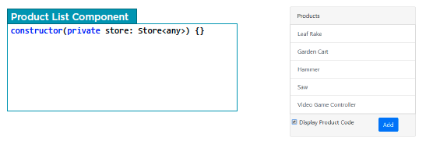
Dispatch an Action
  Dispatch an Action

Slide 14
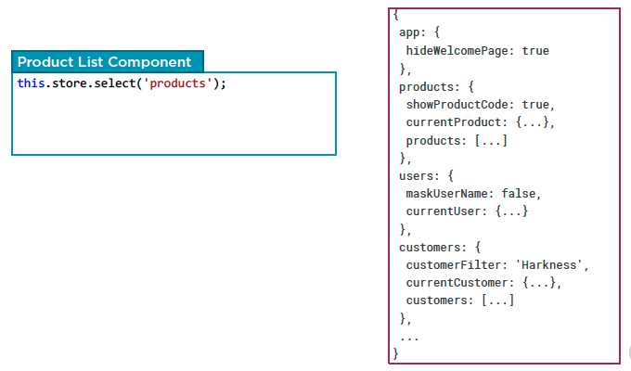
NgRx Case Study
  Subscribe to state changes

Slide 15
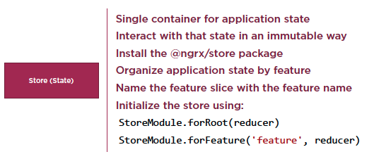
NgRx Case Study
  Checklist: Store

Slide 16
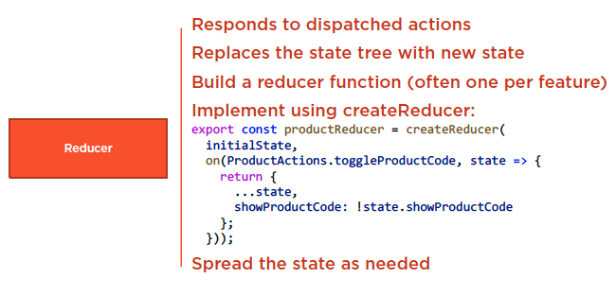
NgRx Case Study
  Checklist: Reducer

Slide 17
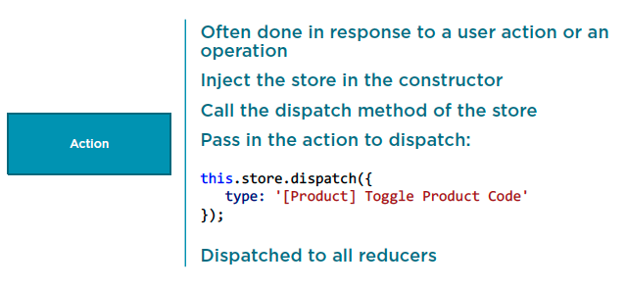
NgRx Case Study
  Checklist: Dispatching an Action

Slide 18
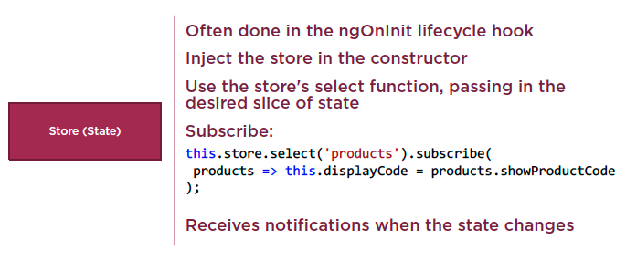
NgRx Case Study
  Checklist: Subscribing to the Store

Slide 19
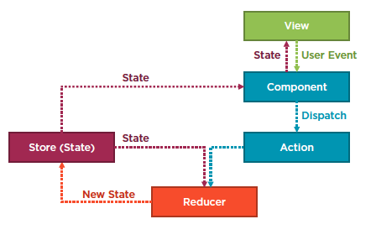
NgRx Case Study

Slide 20
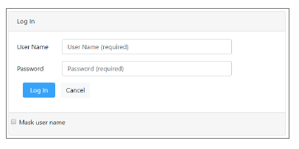
Homework
Login page
Initialize the store in the user module
Define the state and action
Create the reducer function
Dispatach an action
Subscribe to the user slice of state

Slide 21
Reference
Angular NgRx: Getting Started
https://app.pluralsight.com/library/courses/angular-ngrx-getting-started/table-of-contents
Play by Play: Angular and ngrx
https://app.pluralsight.com/library/courses/play-by-play-angular-ngrx/table-of-contents

Slide 22
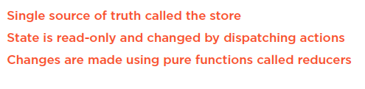
Summary

